Slide 1
Weekly meeting 9
Shengya Guo, CR/AVS3, 28.08.2024

Slide 2
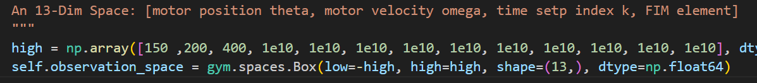
The observation space
Train the RL with all infomation in Observation
The observation space have 13 dimensional:
Motor position, motor velocity, time setp index (3)
upper triangular FIM elements (10)
The scaled FIM is not meaningful for the training of RL, because every time step we have a new scale factor and the elements of the scaled FIM is not comparable
The meaning of scaled FIM is to calculate the reward without overflow problem, so for the reward calculation, this part is still needed

Slide 3
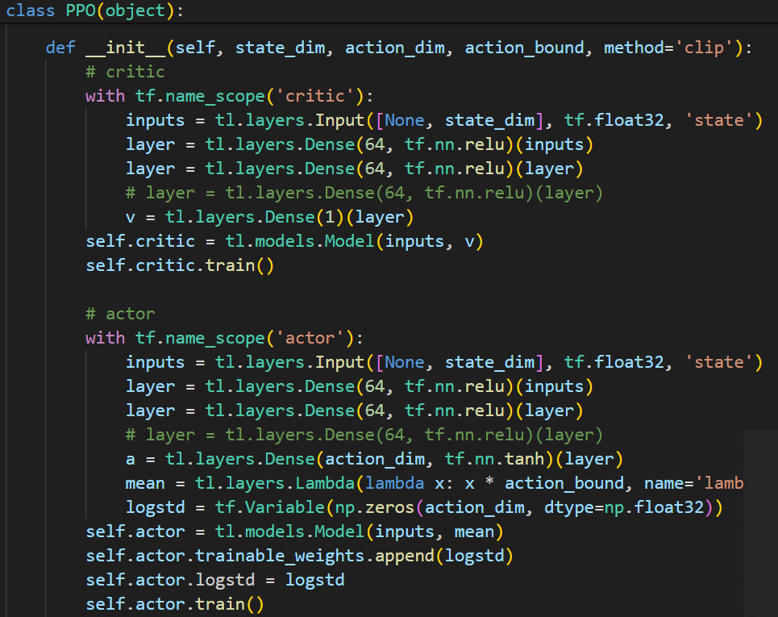
A self-built PPO structure
2 Dense layer with 64 neurons in actor and critic.

Slide 4
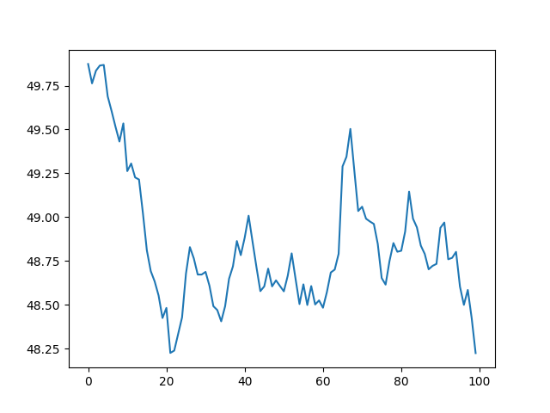
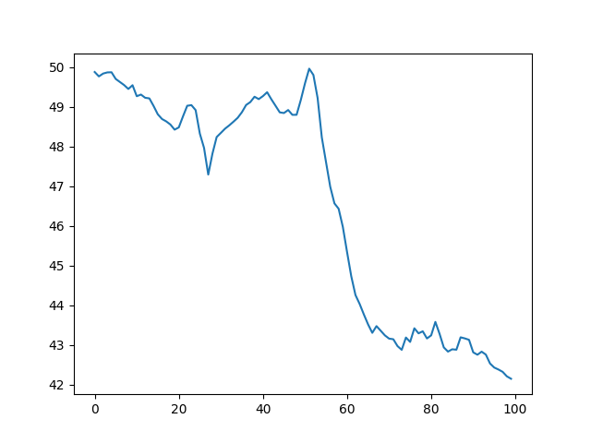
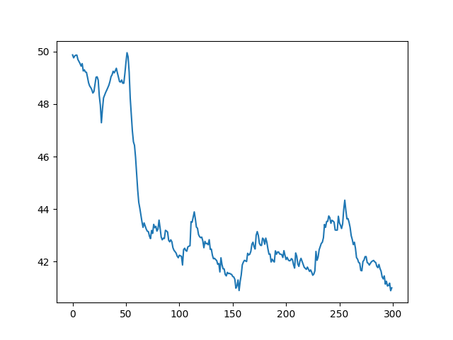
Performance
ppo-clip parameters：0.25, 0.2, 0.2

Slide 5
Drawback
During the learning phase of the vectorized architecture, the PPO shuffles the indices of the training data of size N∗M and breaks it into mini-batches to compute the gradient and update the policy.
Using the whole batch for the update

Slide 6
Drawback
Because each element in the observation space is really different in value, so the observation space normalization is necessary.

Slide 7
The punishment in reward
Next
Position use distance punishment, from some distance, there will be minus reward which is revelvat to the square of the max.position
Velocity use suddenly dead, if v > max.v, really big minus reward and restart.

Slide 8
Next
See if normalize wrapper will let it loose meaning. Maybe normalize with maximal value
Test if it could learn sth just with one parameter, ex viscos para in maxi speed
Position use distance punishment, velocity use suddenly dead
Global Gradient Clipping

